Slide 1

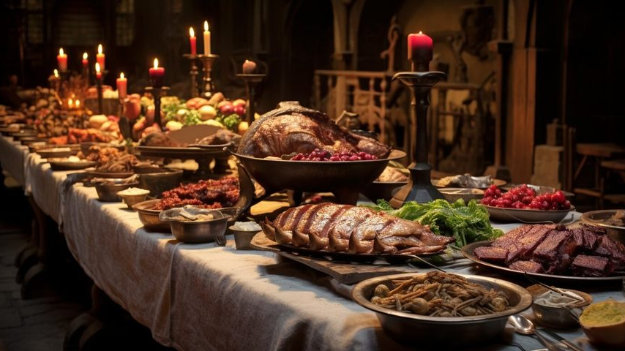
The Royal Banquet of Formats
“Tonight, the Image Kingdom serves its finest digital dishes!”
ITAI-1378
Elijah Raines, Triet Le, Nha Huynh, Richard Rodriguez

Slide 2
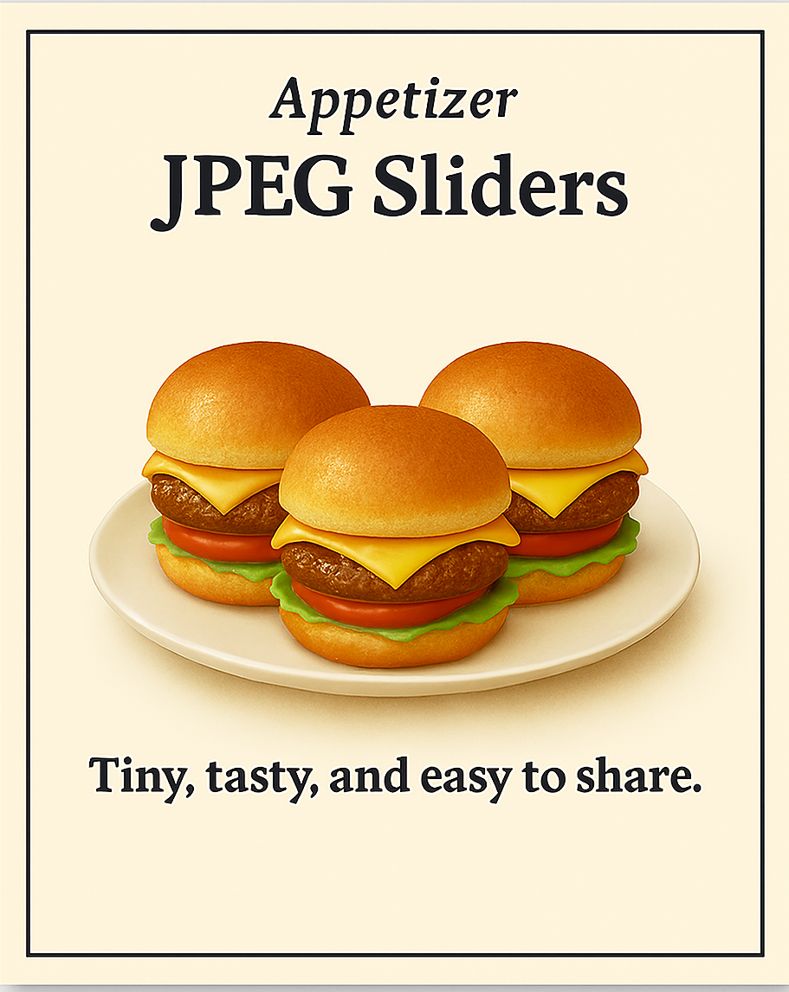
Appetizer: JPEG Sliders
“Tiny, tasty, and easy to share.”
These mini sandwiches are quick to prepare and perfect for crowds. They trim away the unnecessary stuffing to make them light and portable while keeping the flavor enjoyable. Just don’t remake them too often, or the layers lose their punch.
Fun Fact: JPEG comes from the "Joint Photographic Experts Group", not a deli!
Best for: Photographs, web images

Slide 3
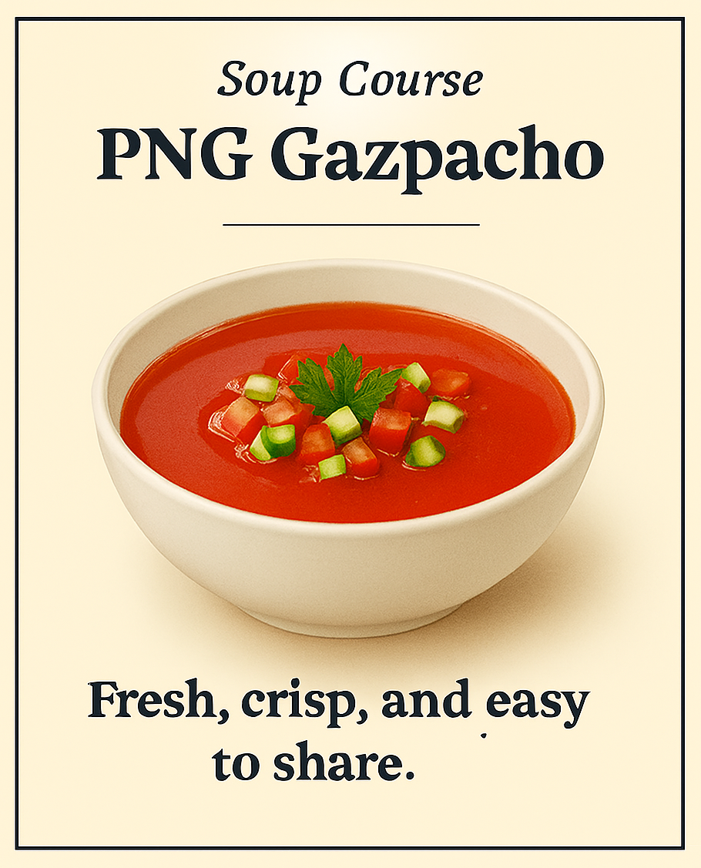
Soup Course: PNG Gazpacho
“Fresh, crisp, and completely preserved.”
A cool, refreshing soup that keeps every vegetable intact. Served with a clear broth and a hint of garnish (supports alpha transparency), it’s perfect for keeping flavors bright and detailed.
Fun Fact: Some pronounce it “ping,” like the sound of a spoon tapping the bowl.
Best for: Logos, graphics, images with transparent background

Slide 4
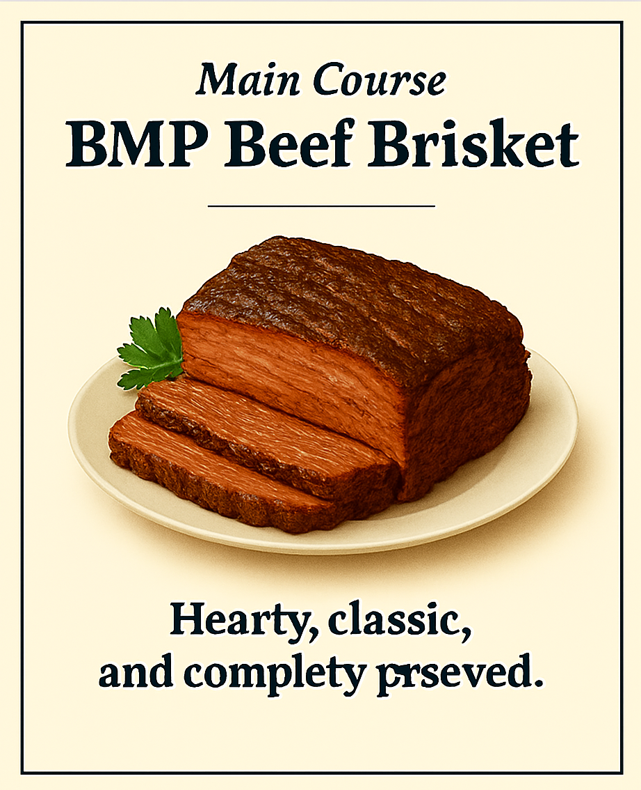
Main Course: BMP Beef Brisket
“Hearty, classic, and unprocessed.”
This slow-cooked brisket is served in all its glory. No trimming, no shortcuts — every fiber and spice is fully intact. Not the easiest to handle, but a favorite among those who appreciate pure, uncompressed flavor.
Fun Fact: BMPs are like meat in a smokehouse — full detail, no loss.
Best for: Raw image storage, technical uses.

Slide 5
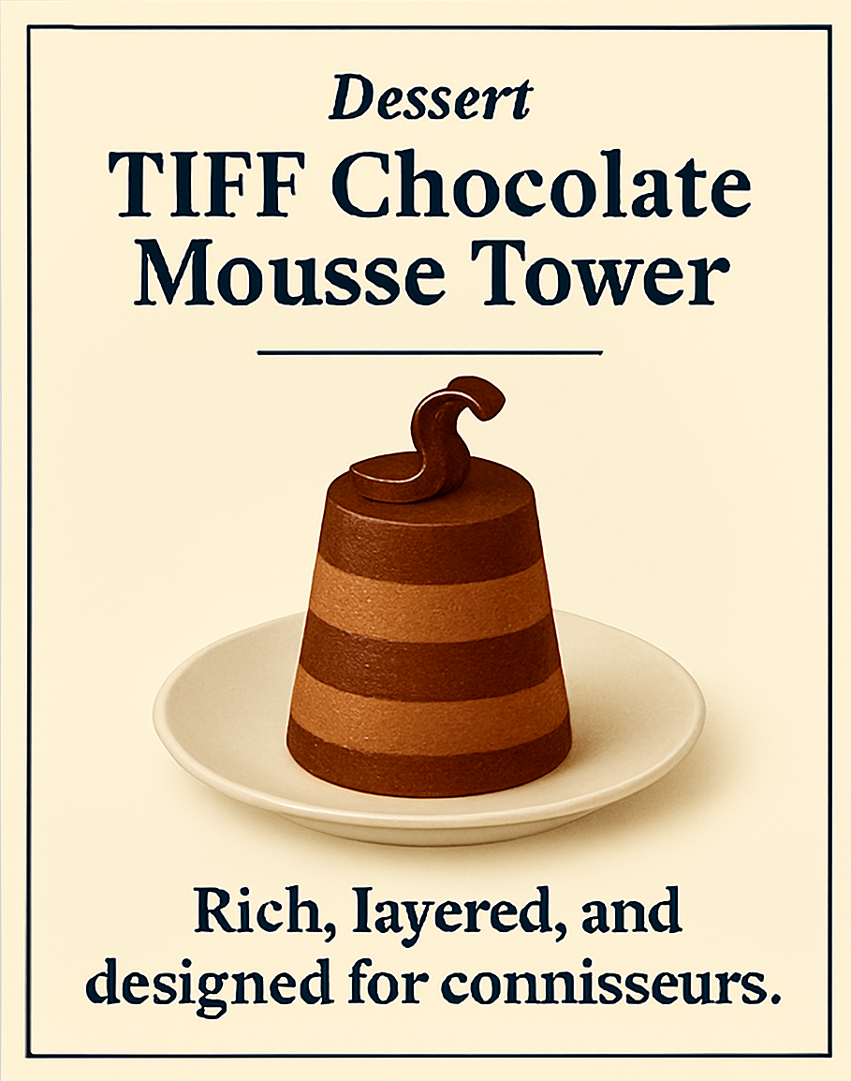
Dessert: TIFF Chocolate Mousse Tower
“Rich, layered, and designed for connoisseurs.”
A towering chocolate mousse with multiple layers and textures that can be crafted for maximum precision or a slightly lighter touch. With this dish, we keep every decadent layer perfectly intact. Served best in professional kitchens where quality is paramount.
Fun Fact: TIFF can hold several images in one file — like hidden mousse layers for the lucky diner
Best for: Archiving, high-resolution images, professional use.

Slide 6
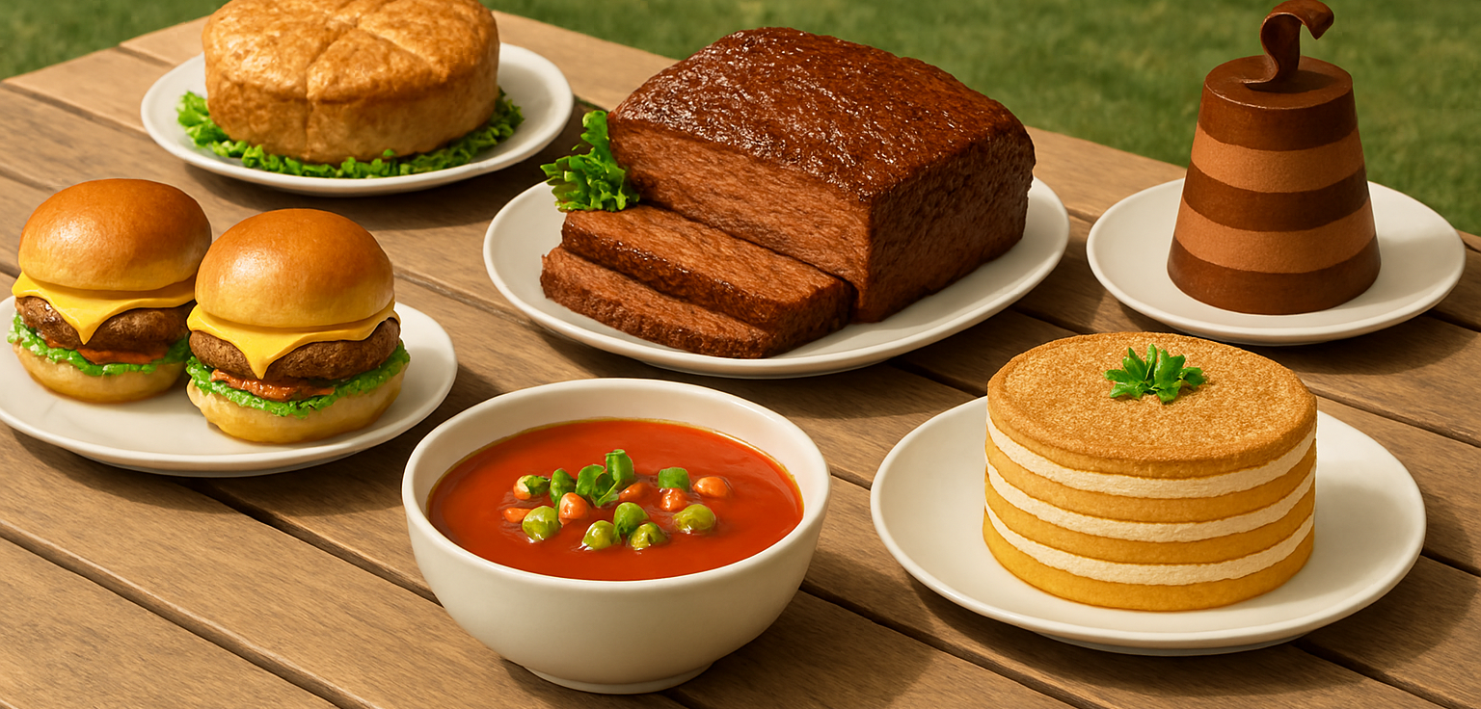
Presenting the royal banquet menu
“Every dish brings a flavor to the kingdom. There's something for everyone at the feast!”

